Slide 1
Cryptography in Java Highly Dependable Systems
Notes:
1

Slide 2
Platform Security
The Java™ platform was designed with a strong emphasis on security
Core language features:
Strong data typing
Automatic memory management
Garbage collection
Range-checking on arrays
Access modifiers (public, protected, private)
Byte-code verification
Secure class loading
Notes:
2

Slide 3
Java Security Technology
Java security technology includes a large set of APIs, tools, and implementations of commonly used security algorithms, mechanisms, and protocols:
cryptography
public key infrastructure
secure communication
authentication
access control
Notes:
3

Slide 4
Basic Security Architecture
Security APIs were designed around the following principles
Implementation independence
Applications request generic security services from the Java platform via providers
Implementation interoperability
Providers are interoperable across applications
Algorithm extensibility
The Java platform includes a number of built-in providers, and supports the installation of custom providers
Notes:
4

Slide 5
Java Security API packages
Java Cryptography Architecture (JCA) is part of Java 2 run-time environment.
🡪 java.security.*
java.security package includes classes used for authentication and digital signature
JCE adds encryption and decryption APIs to JCA.
🡪 javax.crypto.*
javax.crypto package contains Java Cryptography Extension classes

Slide 6
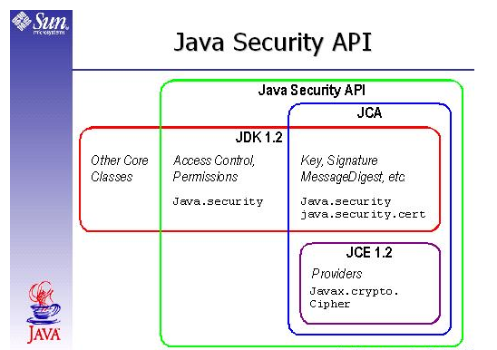
Java Security Architecture

Slide 7
Java Cryptography Extension
The JCE allows different implementations from many providers, by defining different types of cryptographic "engines" (services)
An engine class provides the interface to a specific type of cryptographic service, independent of a particular cryptographic algorithm or provider
Useful classes are:
SecretKeyFactory
Cipher
SealedObject
KeyGenerator
KeyAgreement
Mac
SecureRandom

Slide 8
Requesting a service
To use the JCA, an application:
requests a particular type of object (such as a MessageDigest)
and a particular algorithm or service (such as the "MD5" algorithm)
and gets an implementation from one of the installed providers
try {
MessageDigest md = MessageDigest.getInstance("MD5");
}
catch (NoSuchAlgorithmException e) {
// no such algorithm provided
}
Notes:
8

Slide 9
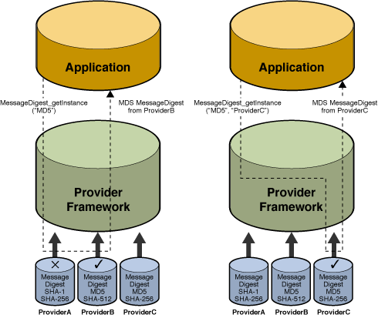
Provider selection
md = MessageDigest.getInstance("MD5"); /* default provider */
md = MessageDigest.getInstance("MD5", "ProviderC");
Notes:
9

Slide 10
Security Providers
Implementation independence is achieved using a "provider"-based architecture
Provider - a package or set of packages that implement one or more security services
import java.security.*;
Provider[] providers =
Security.getProviders();
for (Provider p: providers){
System.out.println(p.toString());
}
SUN version 1.6
SunRsaSign version 1.5
SunJSSE version 1.6
SunJCE version 1.6
SunJGSS version 1.0
SunSASL version 1.5
XMLDSig version 1.0
SunPCSC version 1.6
SunMSCAPI version 1.6
Java 6.0
Notes:
10

Slide 11
JCE Providers
Open source providers: Cryptix and Bouncy Castle
Plugged-in by:
modifying the java.security file
using code to add a provider (dynamically)
Example:
import cryptix.jce.provider.CryptixCrypto;
Provider cryptix_provider = new CryptixCrypto();
int result=Security.addProvider(cryptix_provider);

Slide 12
Listing provider services
Provider[] providers = Security.getProviders();
for (Provider p: providers){
System.out.println(p.toString());
Set<Service> services = p.getServices();
for (Service s: services){
System.out.println(" " + s.getType() +
" --> " + s.getAlgorithm());
}
}
Notes:
12

Slide 13
SUN version 1.6 services
SUN version 1.6 SecureRandom --> SHA1PRNG Signature --> SHA1withDSA Signature --> NONEwithDSA KeyPairGenerator --> DSA MessageDigest --> MD2 MessageDigest --> MD5 MessageDigest --> SHA MessageDigest --> SHA-256 MessageDigest --> SHA-384 MessageDigest --> SHA-512 | AlgorithmParameterGenerator --> DSA AlgorithmParameters --> DSA KeyFactory --> DSA CertificateFactory --> X.509 KeyStore --> JKS KeyStore --> CaseExactJKS Policy --> JavaPolicy Configuration --> JavaLoginConfig CertPathBuilder --> PKIX CertPathValidator --> PKIX CertStore --> LDAP CertStore --> Collection CertStore --> com.sun.security.IndexedCollection
Notes:
13

Slide 14
The SecureRandom Class
Provides the functionality of a Random Number Generator
Produces cryptographically strong random numbers
SecureRandom random = SecureRandom.getInstance("SHA1PRNG");
System.out.println("Int: " + random.nextInt());
System.out.println("Float: " + random.nextFloat());
System.out.println("Long: " + random.nextLong());
System.out.println("Boolean: " + random.nextBoolean());
Int: 256421598
Float: 0.63456607
Long: 7589616350181670704
Boolean: true
Notes:
14
additional requirements of crypto random numbers:
uniqueness (One Time Pads)
high entropy

Slide 15

The MessageDigest Class
Designed to provide the functionality of cryptographically secure message digests such as SHA-1 or MD5
The MD5 algorithm produces a 16 byte digest, and SHA-1's is 20 bytes
Notes:
15

Slide 16
Computing a MessageDigest object
MessageDigest sha = MessageDigest.getInstance("SHA-1");
byte[] i1 = "Hello World".getBytes();
sha.update(i1);
byte[] hash = sha.digest();
System.out.println((new BASE64Encoder()).encode(hash));
byte[] i2 = "Hello World!".getBytes();
sha.update(i2);
hash = sha.digest();
System.out.println((new BASE64Encoder()).encode(hash));
*********************************************************************************************************************************
sha.update(received);
hash = sha.digest();
System.out.println((new BASE64Encoder()).encode(hash));
Ck1VqNd45QIvq3AZd8XYQLvEhtA=
Lve95gjOVATpfV8EL5X4nxwjKHE=
Ck1VqNd45QIvq3AZd8XYQLvEhtA=
Notes:
16

Slide 17
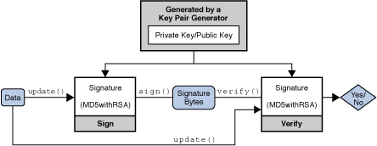
The Signature Class
Provide the functionality of a cryptographic digital signature algorithm such as DSA
Notes:
17

Slide 18
Signature Object States
Signature object is always in a given state, where it may only do one type of operation
The three states a Signature object may have are:
UNINITIALIZED
initSign()
initVerify()
SIGN
VERIFY
Notes:
18

Slide 19
Generating a Pair of public/private Keys
First step is to generate public/private key pair
All key pair generators share the concepts of a keysize and a source of randomness
KeyPairGenerator keyGen = KeyPairGenerator.getInstance("DSA");
SecureRandom random = SecureRandom.getInstance("SHA1PRNG");
keyGen.initialize(1024, random);
KeyPair pair = keyGen.generateKeyPair();
PrivateKey privateKey = pair.getPrivate();
PublicKey publicKey = pair.getPublic();
Notes:
19

Slide 20
Generating/verifying a signature
byte[] data = "Data to be signed".getBytes();
// generating a signature
Signature dsaForSign = Signature.getInstance("SHA1withDSA");
dsaForSign.initSign(privateKey);
dsaForSign.update(data);
byte[] signature = dsaForSign.sign();
// verifying a signature
Signature dsaForVerify = Signature.getInstance("SHA1withDSA");
dsaForVerify.initVerify(publicKey);
dsaForVerify.update(data);
boolean verifies = dsaForVerify.verify(signature);
System.out.println("Signature verifies: " + verifies);
Notes:
20

Slide 21
The Cipher Class
A cryptographic cipher for encryption and decryption can be instantiated using the Cipher.getInstance factory method
Associated with a transformation name in the format, algorithm/mode/padding
Can operate within four modes: encrypt, decrypt, key wrap, key unwrap.
Must be initialized using a specified mode, and secret key information.

Slide 22
Classe Cipher
Methods:
getInstance(String algorithm)
Generates a Cipher object that implements the specified algorithm.
init(int opmode, Key key)
The cipher is initialized with a key for either encryption or decryption.
doFinal(byte[] input)
Encrypts or decrypts data in a single-part operation, or finishes a multiple-part operation, depending on how this cipher was initialized.
update(byte[] input)
Continues a multiple-part encryption or decryption operation.
1.22

Slide 23
Classe Cipher
Class:Javax.crypto.Cipher
Algoritmos
for (String a: Security.getAlgorithms("Cipher")){
System.out.println(a);
}
ARCFOUR PBEWITHMD5ANDDES RC2 RSA PBEWITHMD5ANDTRIPLEDES PBEWITHSHA1ANDDESEDE | DESEDE AESWRAP AES DES DESEDEWRAP RSA/ECB/PKCS1PADDING PBEWITHSHA1ANDRC2_40
Notes:
23

Slide 24
Usar Cifra (AES)
// Gerar chave AES
KeyGenerator keygen = KeyGenerator.getInstance("AES");
keygen.init(128); // initialize the key size
SecretKey aesKey = keygen.generateKey();
//Obter bytes da chave
aesKey.getEncoded();
// Initializar object de cifra
Cipher aesCipher = Cipher.getInstance("AES/ECB/PKCS5Padding");
aesCipher.init(Cipher.ENCRYPT_MODE, aesKey);
byte[] cleartext = "Data to be encoded".getBytes();
// Cifar cleartext
byte[] ciphertext = aesCipher.doFinal(cleartext);
// Inicializar cifra para decifar
aesCipher.init(Cipher.DECRYPT_MODE, aesKey);
// Decifrar criptograma
byte[] cleartext1 = aesCipher.doFinal(ciphertext);
Notes:
24

Slide 25
Geração de chaves simétricas
Gerar chave
Gravar chave
Ler chave
Notes:
25

Slide 26
Exceções
try {
// algorithm from previous slide
. . .
System.out.println("Cipher successful!");
}
catch (NoSuchAlgorithmException e1) {. . .}
catch (NoSuchPaddingException e2) {. . .}
catch (BadPaddingException e3) {. . .}
catch (InvalidKeyException e4) {. . .}
catch (IllegalBlockSizeException e5) {. . .}
Notes:
26

Slide 27
JCE - KeyGenerator
The KeyGenerator class solves the problem of Alice or Bob having to come up with their own secret key. It will create one for them.
Symmetric algorithms have their own specific weak keys. Users who use weak keys open their communication to known exploits. For example, a weak key for DES is:
0000000 FFFFFFF.
Uses a random number generator, a key size, and a target cryptographic algorithm (like ‘DES’) to generate an acceptable key for the developer.
Example:
KeyGenerator kg = KeyGenerator.getInstance(“DES”);
kg.init(56);
SecretKey sk = kg.generateKey();

Slide 28
JCA - Secure Key Storage
Keys need to be stored on secondary storage so that programs can access them conveniently and securely for subsequent use.
JCA provides an extensible architecture to manage keys through KeyStore.
A KeyStore object maintains an in-memory table of key and certificate entries, indexed by alias strings, allowing retrieval, insertion and deletion of entries.
Keystore files are usually password protected.

Slide 29
Class: java.security.KeyStore
Methods:
getInstance (String type)
Create an instance of KeyStore of the specified type.
load(InputStream stream, char[] password))
Open keystore with password and load keys from keystore file to memory
getKey(String alias, char[] password)
Access the keystore with password and get the key based on a given key alias
setEntry(String alias, KeyStore.Entry entry,
KeyStore.ProtectionParameter protParam)
Set a new key entry in the keystore
store(OutputStream stream, char[] password)
Store this keystore to the given output stream, and protect its integrity with the given password.

Slide 30
Example: Create an empty KeyStore object
The following sample creates an empty KeyStore object with password protection.
// Create an instance of KeyStore of type “JCEKS”.
// JCEKS refers the KeyStore implementation from SunJCE provider
ks = KeyStore.getInstance("JCEKS");
// Load the null Keystore and set the password to “changeme”
ks.load(null, "changeme".toCharArray());

Slide 31
Example:Set Key Entry
The following sample sets the generated key “mykey” in the KeyStore.
//Create an instance of KeyStore.SecretKeyEntry using “mykey”
KeyStore.SecretKeyEntry skEntry = new KeyStore.SecretKeyEntry(mykey);
//Get key alias name from user input.
String alias=args[0];
//Create KeyStore Password
KeyStore.PasswordProtection password;
password = new KeyStore.PasswordProtection("changeme".toCharArray());
//Set the key entry in the key store with an alias.
ks.setEntry(alias, skEntry, password);

Slide 32
Example:Store KeyStore object in file
The following sample writes the KeyStore object into a file for storage.
//Create a new file to store the KeyStore object
java.io.FileOutputStream fos = new java.io.FileOutputStream("keystorefile.jce");
//Write the KeyStore into the file
ks.store(fos, "changeme".toCharArray());
//Close the file stream
fos.close();

Slide 33
Example:Retrieving Keys from KeyStore
The following sample retrieves keys from a KeyStore file.
//Open the KeyStore file
FileInputStream fis = new FileInputStream("keystorefile.jce");
//Create an instance of KeyStore of type “JCEKS”
ks = KeyStore.getInstance("JCEKS");
//Load the key entries from the file into the KeyStore object.
ks.load(fis, "changeme".toCharArray());
fis.close();
//Get the key with the given alias.
String alias=args[0];
Key k = ks.getKey(alias, "changeme".toCharArray());

Slide 34
JCE - SealedObject
For securely persisting objects that can be serialized.
Instantiated with a Cipher object and a serializeable object.
Any algorithm parameters used by the Cipher object are stored in the SealedObject for easy decryption.

Slide 35
JCE - KeyAgreement
Lets Alice and Bob establish a secret key in an insecure environment.
Uses an asymmetric system. A developer must choose the key agreement algorithm. (e.g., Diffie-Hellman)
The ‘generateSecret’ method returns the established secret key
The ‘doPhase’ method performs the exchange
Example:
KeyAgreement ka = KeyAgreement.getInstance(“DH”);
ka..init( alicePrivateKey );
ka..doPhase( bobPublicKey, true );
byte[] secret = ka.generateSecret();

Slide 36
Authentication in Java
Notes:
36

Slide 37
Definitions
Authentication is the process of determining the identity of a user
Authorization is the process of giving user permission to do or to have something
Logically, authorization is preceded by authentication
Notes:
37

Slide 38
JAAS
Java™ Authentication and Authorization Service:
Authentication and user-based access control services in Java
JAAS can be used for two purposes:
for the authentication of users
to reliably and securely determine who is currently executing Java code
for the authorization of users
to ensure they have the access control rights (permissions) required to do the actions performed
Notes:
38

Slide 39
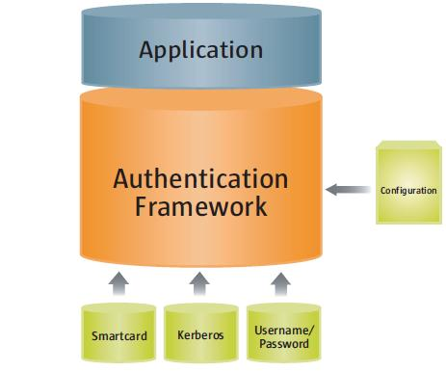
Authentication in Java
JAAS authentication is performed in a pluggable fashion
pluggable login modules
Notes:
39

Slide 40
Authentication mechanics
Applications call into the LoginContext class, which in turn references a configuration
The configuration specifies which login module is to be used to perform the actual authentication
an implementation of the interface javax.security.auth.spi.LoginModule
import javax.security.auth.login.*;
LoginContext lc =
new LoginContext(<config file entry name>,
<CallbackHandler to be used for user interaction>);
lc.logn();
Notes:
40

Slide 41
Built-in login modules
The Java platform provides the following built-in LoginModules:
Krb5LoginModule
for authentication using Kerberos protocols
JndiLoginModule
for username/password authentication using LDAP or NIS databases
KeyStoreLoginModule
for logging into any type of key store, including a PKCS#11 token key store
Notes:
41

Slide 42
The Login Configuration
A login configuration file consists of one or more entries, each specifying which underlying authentication technology should be used
<name used by application to refer to this entry> {
<LoginModule> <flag> <LoginModule options>;
<optional additional LoginModules, flags and options>;
};
LoginDomain {
sample.SampleLoginModule required debug=true;
com.sun.security.auth.module.NTLoginModule sufficient;
com.foo.Kerberos optional debug=true;
};
Notes:
42

Slide 43
Specifying login config file
The configuration file to be used can be specified by setting java.security.auth.login.config system property
As a command line argument:
In program code:
java -Djava.security.auth.login.config==login.config
System.getProperties().setProperty(
"java.security.auth.login.config",
"login.config");
Notes:
43

Slide 44
Secure Software Implementation

Slide 45
Secure Software Implementation
Follow standards and recommended key sizes blessed by the cryptographic community
Peer review a design and its implementation
Avoid writing protocols from scratch
JCE offers no silver bullet
Destroy information that is no longer needed
In Java, all objects remain on the heap. Heap is garbage collected. Remove content in the garbage collector.
Java makes no guarantee when an object is released from memory, even when calling System.gc()
Remove memory allocated for local variables
Using commands like ‘memset’ in C programming
Minimize copies of the sensitive information
Wipe your StringBuffer instances
The paranoid ought to consider JNI (Java Native Interface)

Slide 46
Counter Mode
To get a “plain” cipher use ECB mode with no padding
Warning! CBC mode used by default
Need to specify “AES/ECB/NoPadding”
Need a counter?
try BigInteger

Slide 47
Notes:
47

Slide 48
Generating MACs in Java
Sequence of Steps:
Create a KeyGenerator for HmacMD5
Generate the shared secret
Create a MAC object, initialize it with shared secret (init method)
Pass byte array to "doFinal" method of MAC
1.48

Slide 49
Generating MACs (example)
KeyGenerator keygen = KeyGenerator.getInstance("HmacMD5");
SecretKey sk = keygen.generateKey();
Mac authenticator = Mac.getInstance(sk.getAlgorithm());
authenticator.init(sk);
byte[] msg = "Hello World".getBytes();
byte[] msgAuthenticator = authenticator.doFinal(msg);
1.49

Slide 50
Agradecimentos e Referências
Conteúdo baseado no material dos Profs. Ricardo Chaves, Miguel Matos, Paolo Romano, Douglas Lyon
1.50

